Slide 1
MAGFest 2025 Soldering Workshop
Emily Anthony

Slide 2
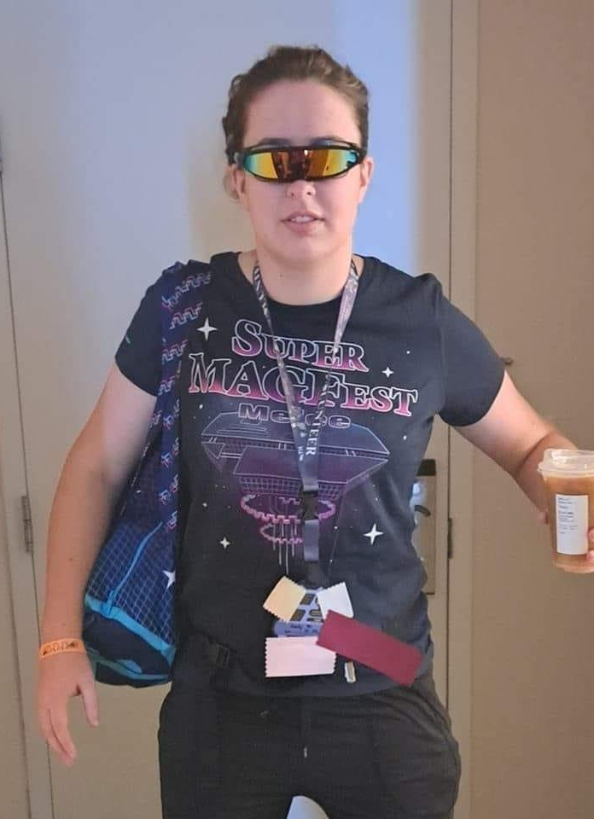

Introductions
Emily
Swadge Department Head
Cosplayer
Engineer
www.thelegendofemily.com
Helpers

Slide 3
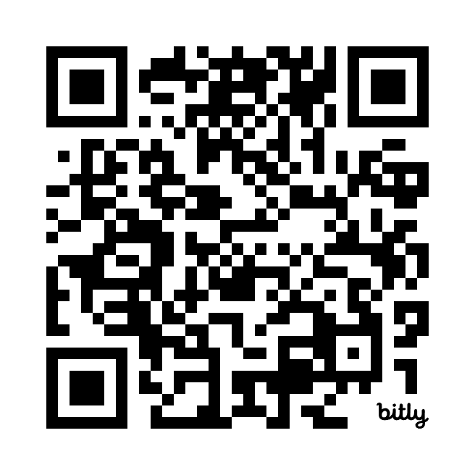
Are you following a printed version?
Follow along with a video of me building this here. No sound, just visual
https://bit.ly/solderMagfest
Ask for help if you need it!

Slide 4
Agenda
Classroom (30m)
Soldering Terminology
How to Solder
What are we building today?
Safety Brief
Lab (90m)
The PCB
Resistors
Capacitors
LEDS
Connector

Slide 5
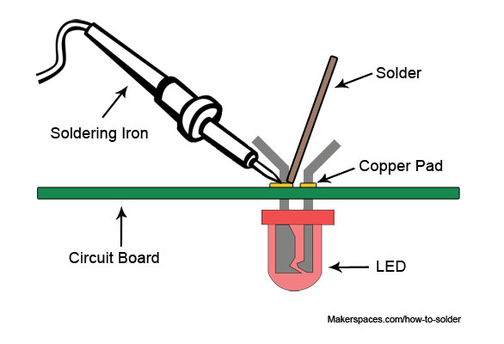
Soldering Terminology and Tools
“Soldering iron” is a hot iron with a pen end to meld solder around electrical connections
“Solder” is a metal alloy that is melted to create a bond between electrical parts
“Flux” is a wax or synthetic material that is used to improve mechanical properties and bond of the solder to electrical contacts

Slide 6
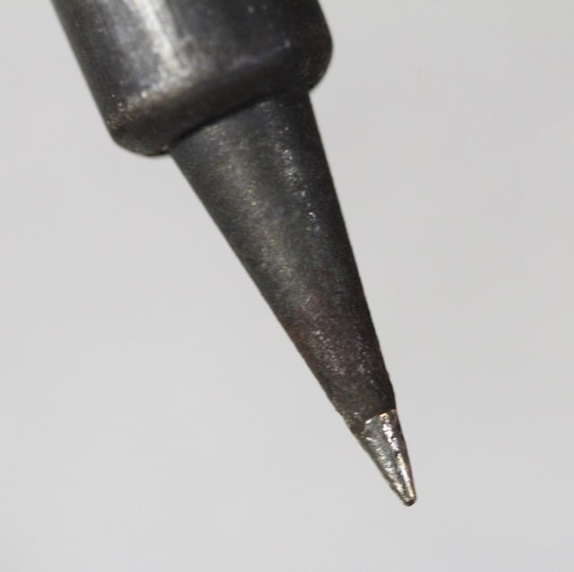
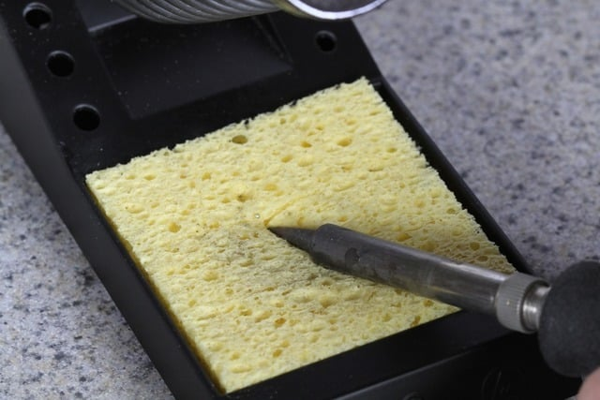
Soldering Terminology and Tools
Solder tips are cleaned when hot by rolling them over a wet sponge
“Tin the tip” is a process to cover a newly cleaned iron tip with a small layer of solder
It is recommended to clean and tin the tip of your iron a couple of times during this workshop

Slide 7
Soldering Terminology and Tools
Solder Sucker
Flux Paste
Wick Braid
ESD Tweezers
Helping Hand

Slide 8
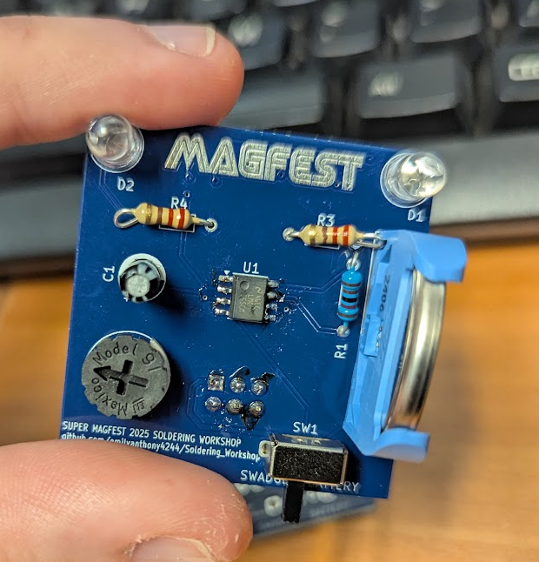
Board Terminology
“PCB” or a “Printed Circuit Board” is a multi-layer board made of fiberglass, resin, and copper (mostly)
“Component” is any item attached to the board
“Copper Pad” is the exposed area on a board that is ready for soldering
“Reference Designator” is the shorthand note on the board for the component
“Thru Hole” is a component that has holes through the board for mounting
“Surface Mount” is a component that mounts on one side of the board only

Slide 9
How to Solder: summary of steps
Turn on Soldering Iron and get it up to temperature
Clean soldering tip on a wet sponge
“Tin” the tip
(the above steps have been done for you)
Place Component on board in the correct orientation
Heat the joint with the tip
Apply solder while tip is at joint
Remove Solder Wire
Remove Tip and Inspect

Slide 10
Step 1: place the component in the correct location and orientation
Component orientation and positioning is critical. For each component on the board, we will tell you how to place it
On some components, such as our resistors, orientation doesn’t matter
Some components, like our Timer and Capacitor, have a dot to indicate orientation
Every component has an alphanumeric Reference Designator to tell you where to put it

Slide 11
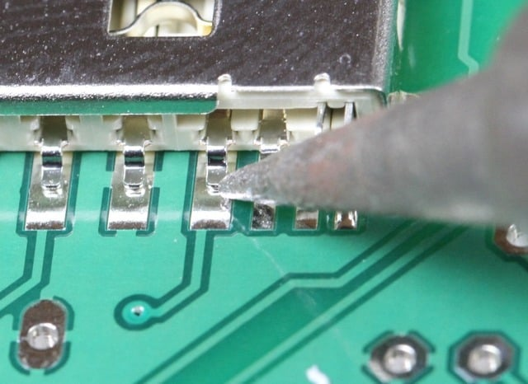
Step 2: Heat the Joint with the Tip
Place the hot iron on the pad to preheat it
Make sure the iron is touching the pad on the PCB and not the component. This is to make sure there is enough heat in the solder pad and to avoid damaging the component

Slide 12
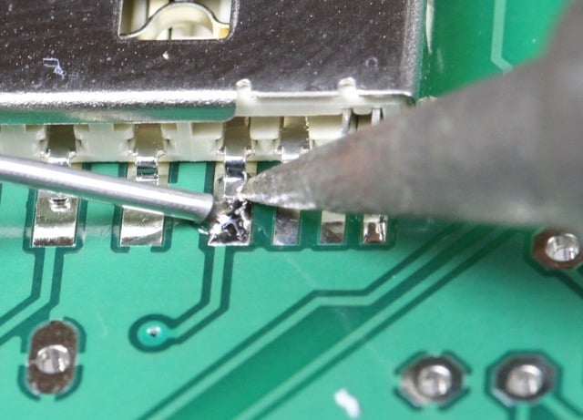
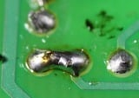
Step 3: Apply solder to the joint
Solder looks like wire, and melts quickly. Place the tip of the solder on the pad and press gently
Too much solder can lead to bridging of adjacent pads
Too little solder may not provide sufficient connection

Slide 13
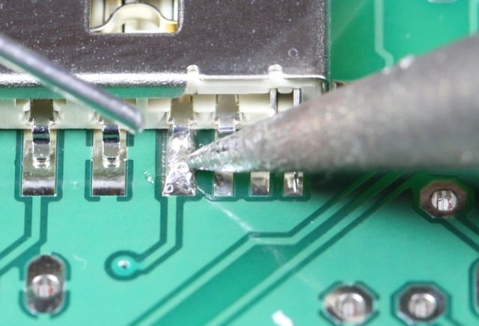
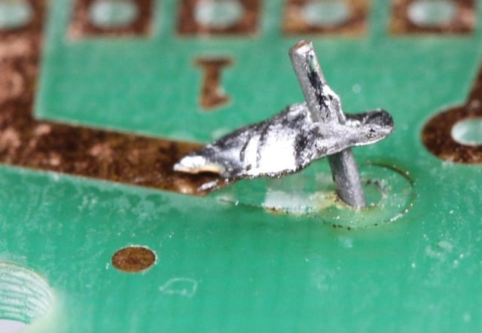
Step 4: Remove the solder wire
Do not remove the iron first
If you remove the iron first, you risk cooling the solder wire to the pad and ripping it when you pull it away

Slide 14
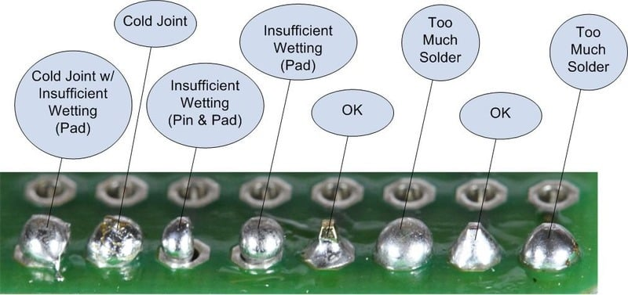
Step 5: Remove the tip and inspect

Slide 15
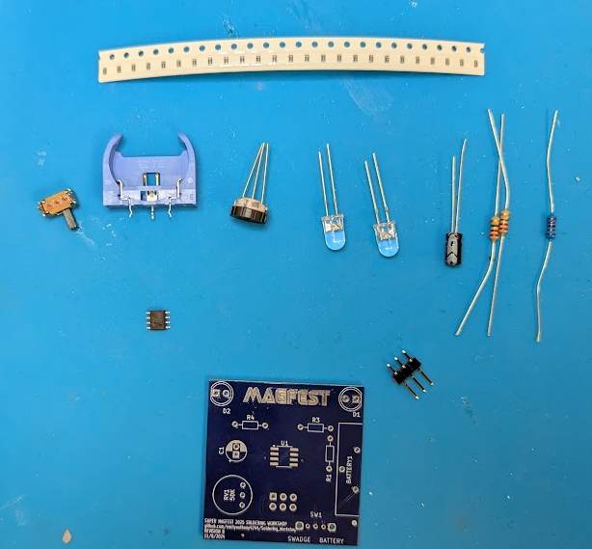
Okay… so what are we building?
This is a custom designed PCB for this lab that can connect to your Swadge
It has 2 LEDS and a 555 timer to flash the LEDs, with a knob to adjust the flashing speed
We will assemble the PCB in steps together, going from least to most difficult components
Note: This can work without a swadge

Slide 16
Two Options
Build with a battery
Get:
1 bagged kit
1 blue battery holder
1 battery
2 leds, any color
Build to connect a swadge
Get:
1 bagged kit
1 2x3 pin header
2 leds, any color
Or get both! Your choice.

Slide 17
Safety Brief
Soldering irons are hot. Do not touch your skin or others with them, or place them on a work table. They may only be in your hands or in the holder.
The Solder we are using has Lead in it. Lead is hazardous to your health when ingested. Wash your hands after soldering and DO NOT EAT while participating in this workshop. You may wear nitrile gloves.
It is recommended to wear protective eyewear.
It is recommended to wear a mask.
Note the location of a fire extinguisher nearby, AED, and emergency exits.

Slide 18
Any questions before we get started?

Slide 19
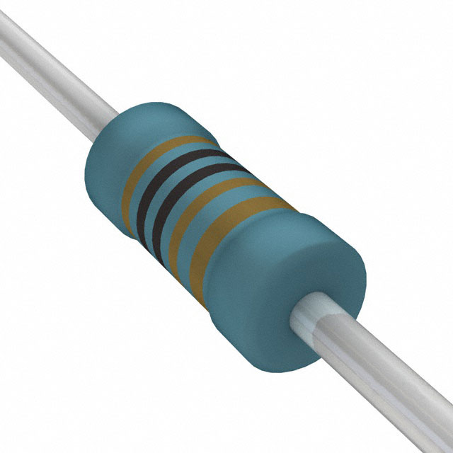
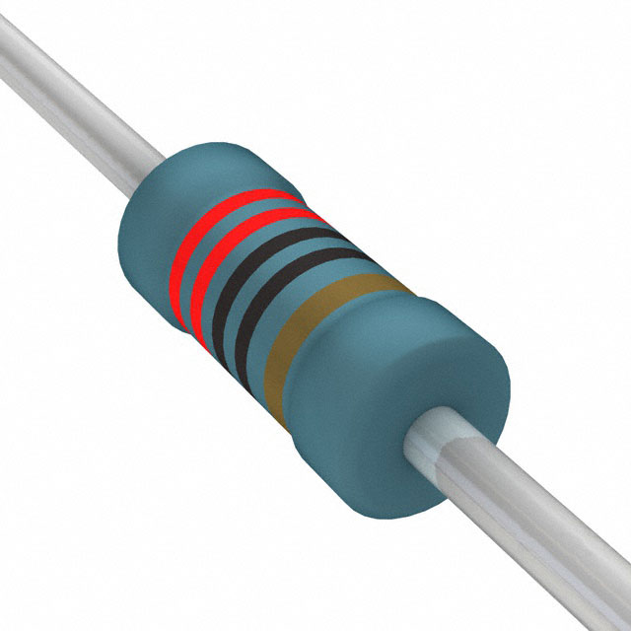
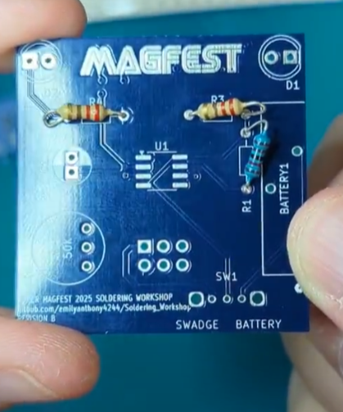
Step 1: The resistors
There are 3 resistors in your bag
There are two different types. 2 of one, 1 of the other. Examine the bands of colors for the difference
Install the single one in R1
Install the other two in R3 and R4
Trim the leads with cutters when you are done
1x
2x

Slide 20
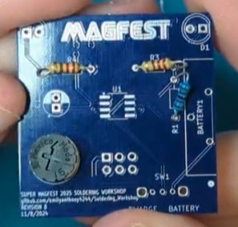
Step 2: knob
Pretty self explanatory. Make it land in the circle drawn for it at RV1
Trim the leads when you are done

Slide 21
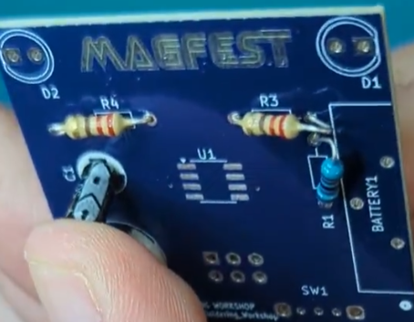
Step 3: The capacitor
The capacitor is Polarized
This means the way it gets installed matters!
Look for the white marking on the body and align it with the white marking on the PCB
Again, trim the leads when you are done!

Slide 22
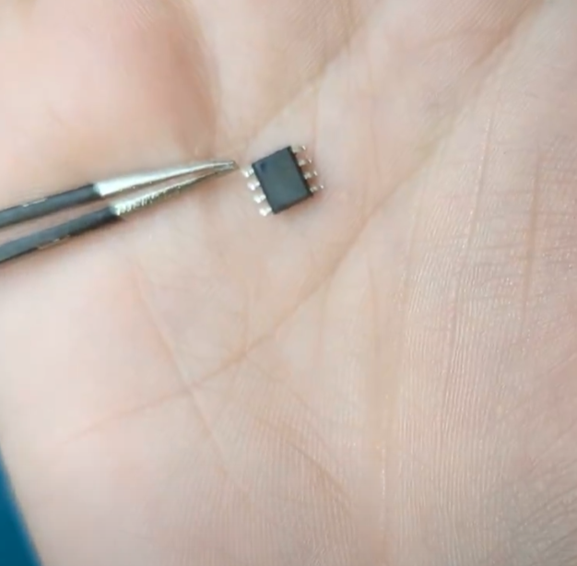
Step 4: The surface mount timer
The timer has a small mark noting its orientation
Look at the piece and inspect it
See the dot?

Slide 23
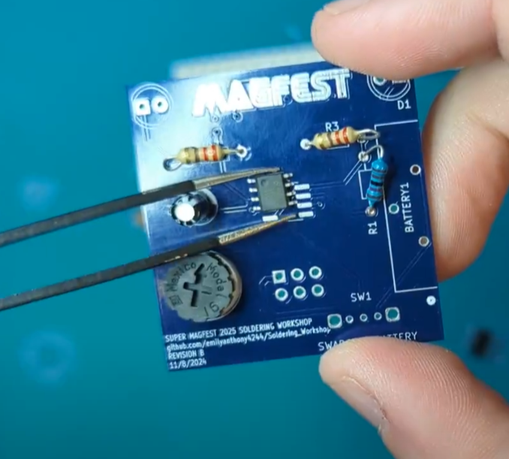
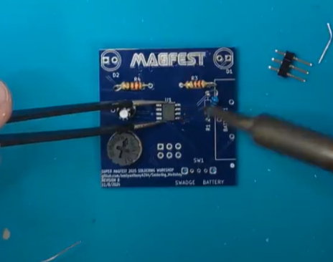
Step 4: Timer continued
Make sure you place the timer in the correct orientation! See the image on the right
Use tweezers or flux to help hold it in place – ask for tools if you need them
Solder one of the corners first, and then another
Make sure you solder each connection

Slide 24
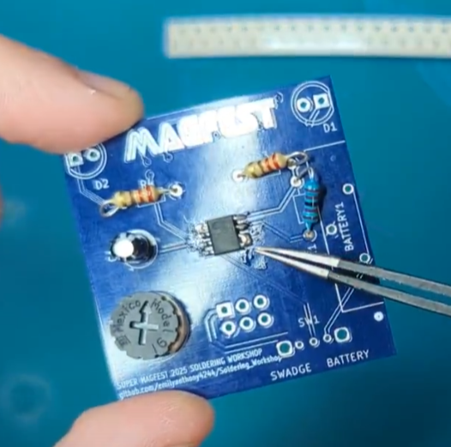
Oh no, I bridged two pins!
This is okay
Ask for the solder sucker
Plunge the sucker down
Heat the joint with the iron, do not remove
Place the sucker and press the button to suck the liquid solder up

Slide 25
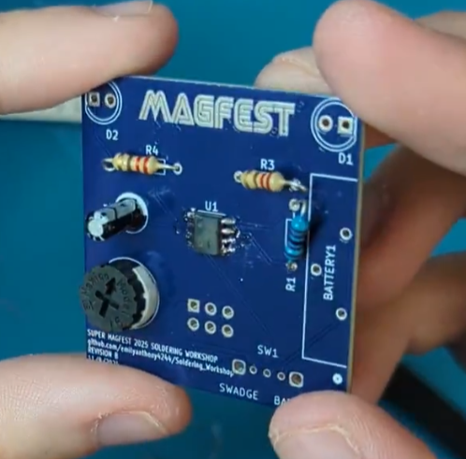
Inspect the pins after before moving on
Looks good!

Slide 26
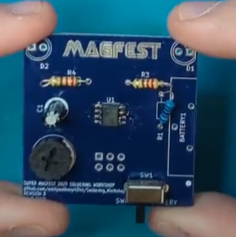
Step 5: Power switch
Back to thru-hole (yay, you lived!)
Place on the front side of the board, and then flip it over and rest it on your mat to solder the back
Connect one of the small MIDDLE pins first, and then the ends

Slide 27
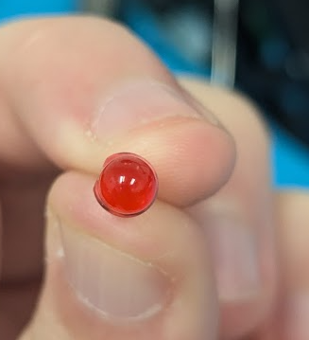
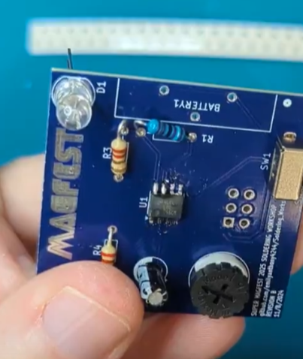
Step 6: LEDs
Pick your two favorite colors
The LEDs have a polarity just like the capacitors
Inspect the board; you’ll see a flat side of the circle for the LEDs D1 and D2
Inspect the LED, you’ll see the same flat
Note that the flats are facing opposite sides
Align the flats and solder
Trim your leads after!

Slide 28
Oh no, I put my LED in the wrong way!
Trim the leads down as low as possible, and use the solder sucker
Heat the joint with the iron, do not remove
Use sucker
Pull away
Get a new LED

Slide 29
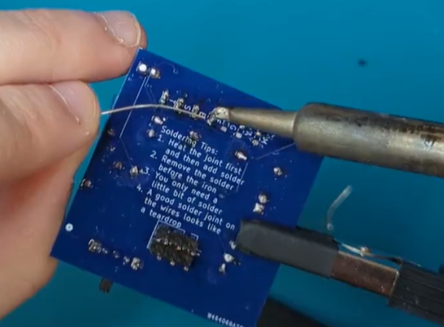
Bonus content: Surface Mount Resistors on the back
Do this before the battery
If you want a challenge, pick 6 surface mount resistors out (the same or different resistance) out of the booklet at a high impedance (30kOhm or above)
Place solder on one pad of each resistor spot labeled M A G F E S T

Slide 30
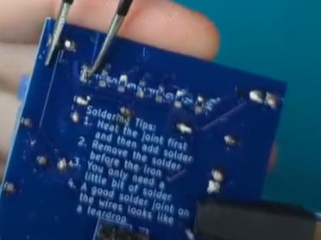
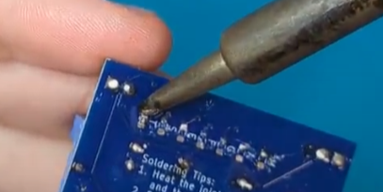
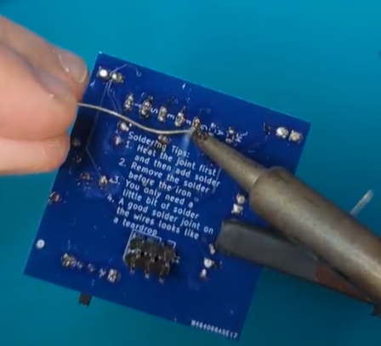
Bonus content: Surface Mount Resistors on the back
1
Place the resistor on the pad
You can use flux paste to hold it still
Recommend tweezers
Remelt the solder of the pad you just put solder on with the resistor attached
Solder the other side
This is hard, don’t sweat it if you can’t get it. You can do any number of them. It won’t impact the circuit in the end
2
3

Slide 31
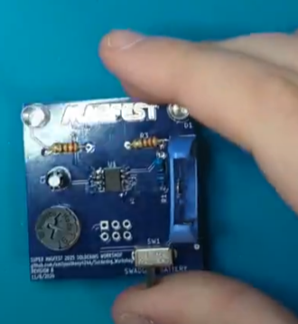
Step 7: Battery Mount
The battery mount must be clipped in with the open side facing out!

Slide 32
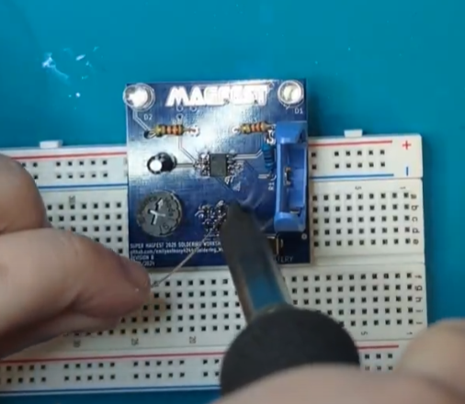
Step 8: Swadge SAO header Mount
Place the header on the BACK of the board, not the front!!
Solder on the front
Use a breadboard to hold it if you are having trouble (but you should be ok)

Slide 33
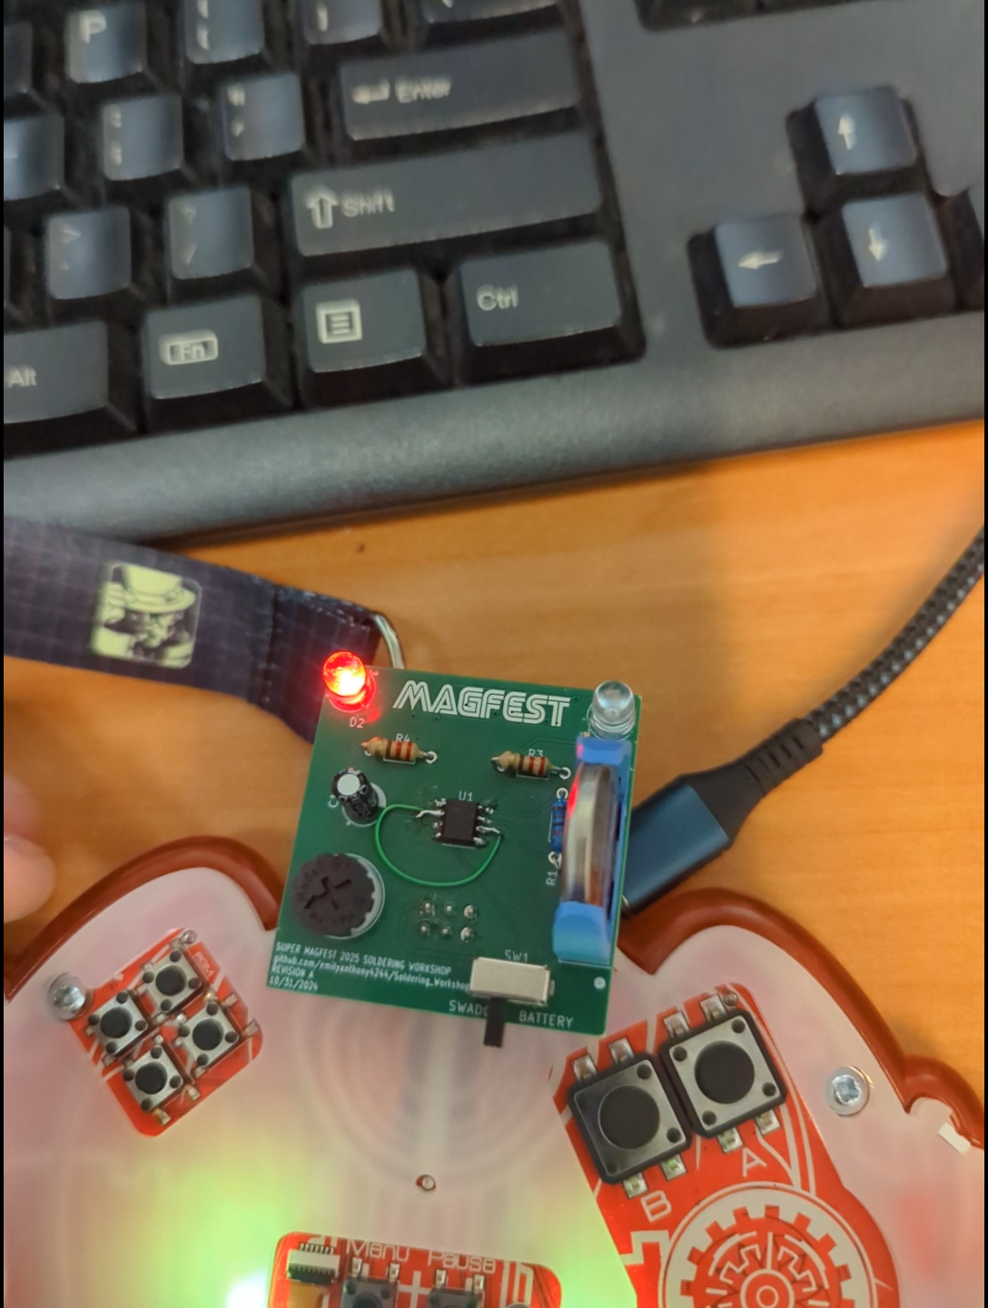
Congrats!
Turn the power on to inspect your work
The leds should flash back and forth
Turn the knob to change the rate at which they flash

